Slide 1
Hand Gesture Controlled Car
By Gone Ramu

Slide 2
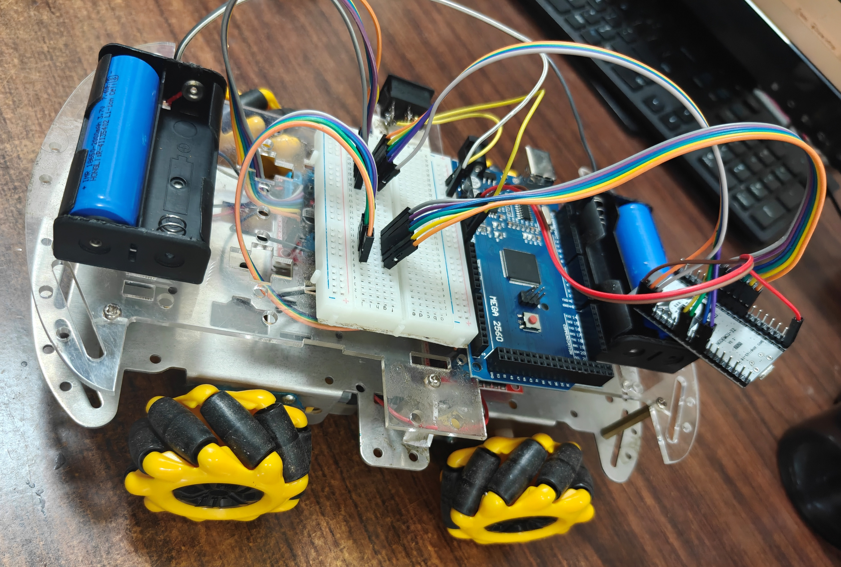
Project Aim
To make a Hand Gesture Controlled Car using Esp32 and MPU6050

Slide 3
Apparatus Required
Hardware Tools :
2 Esp32 – S
IMU MPU6050
2 Motor Drivers
4 DC Motors
4 Mechano Wheels
Bread Board
Battery Source
Jumper wires

Slide 4
Apparatus Required
Software Tools :
Arduino IDE
Esp 32 Board Manger
I2C Dev Library
MPU6050 Library

Slide 5
Procedure
Download the ESP 32 Board manager using the link.
https://dl.espressif.com/dl/package_esp32_index.json
Install and Select Esp 32 in Board Manager in Arduino.
Download the MPU6050 and I2C Dev Libraries using the link.
https://github.com/jrowberg/i2cdevlib
Make Circuit connections for Receiver and Transmitter.
Upload the mac address code to get mac address.
Upload the Transmitter and Receiver code.
Hand Gesture Controlled Car is ready.

Slide 6
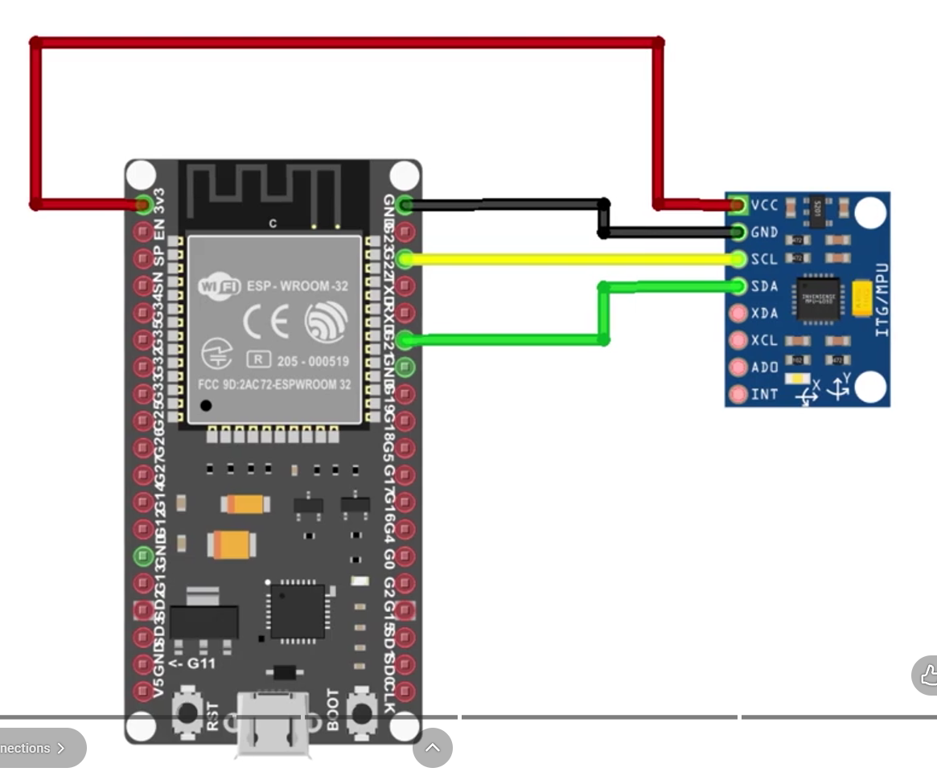
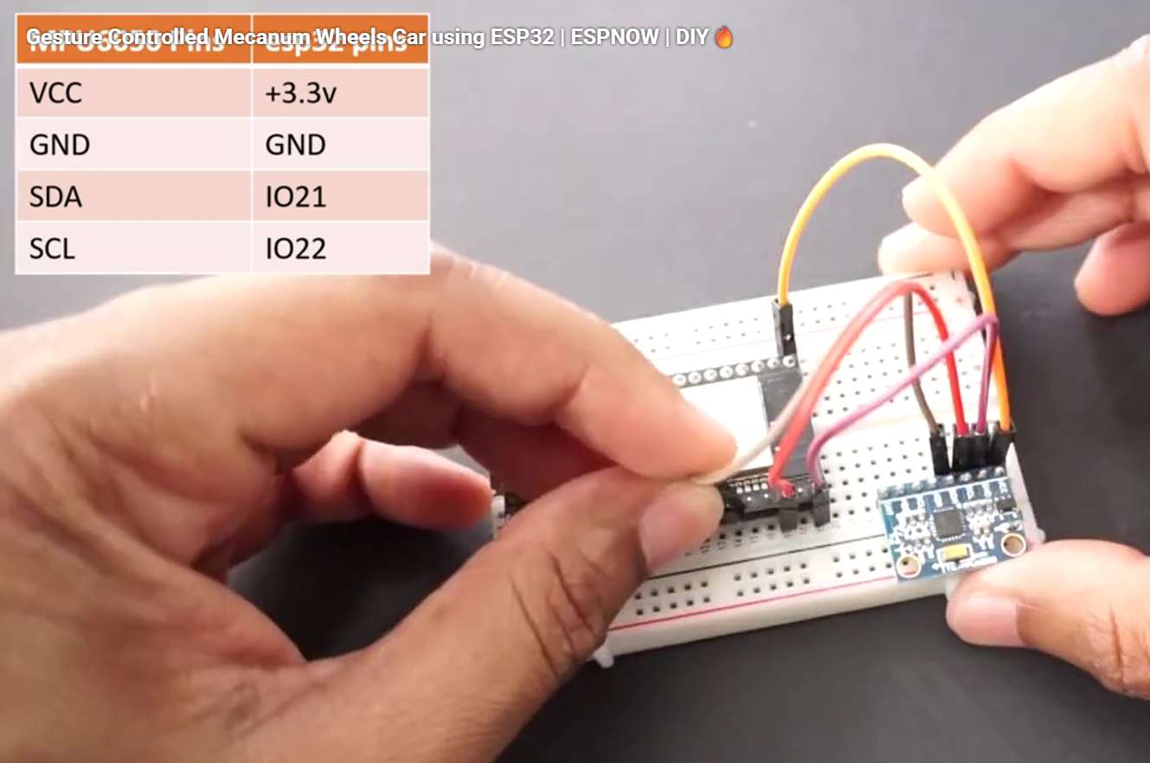
Circuit Connections With MPU6050

Slide 7
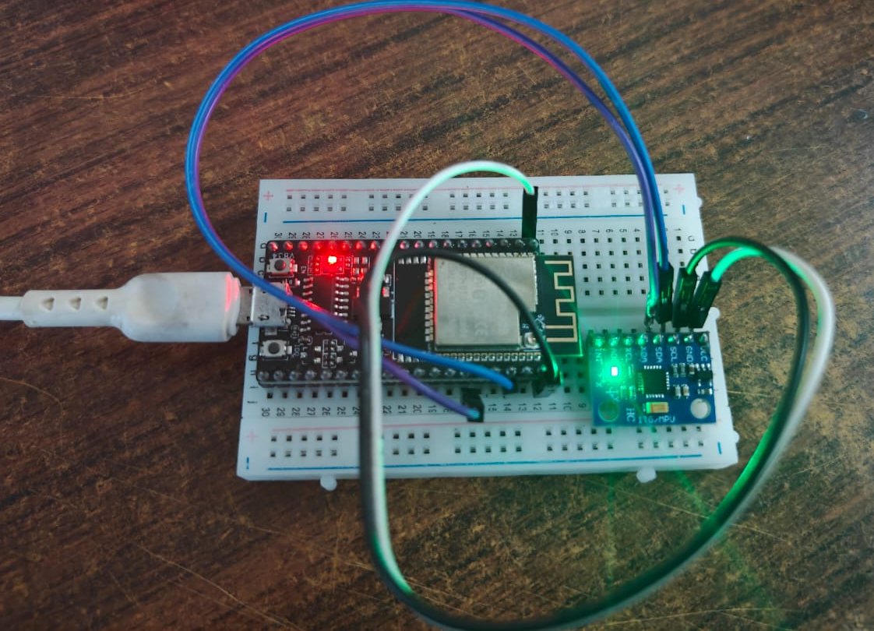
Circuit Connections With MPU6050

Slide 8
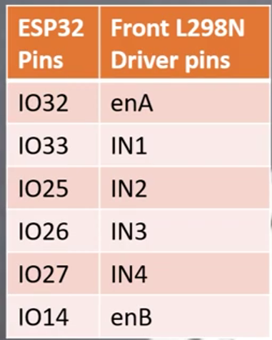
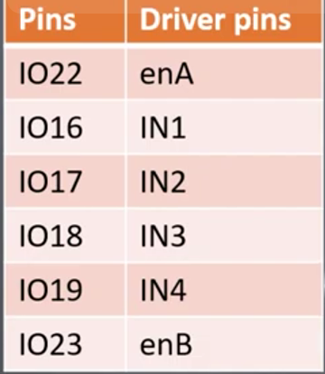
Circuit Connections with Motor driver

Slide 9
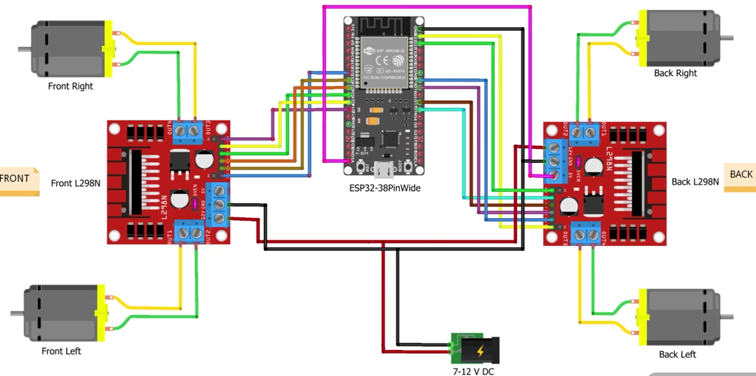
Receiver Circuit Connection

Slide 10
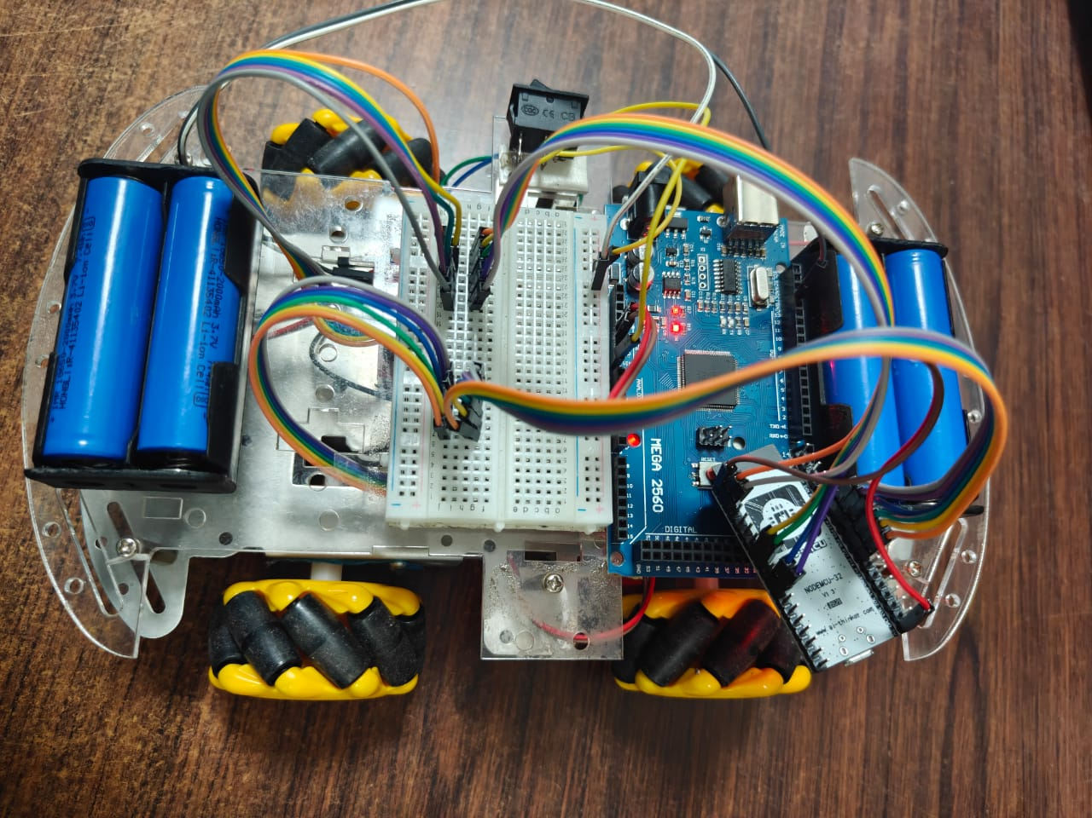
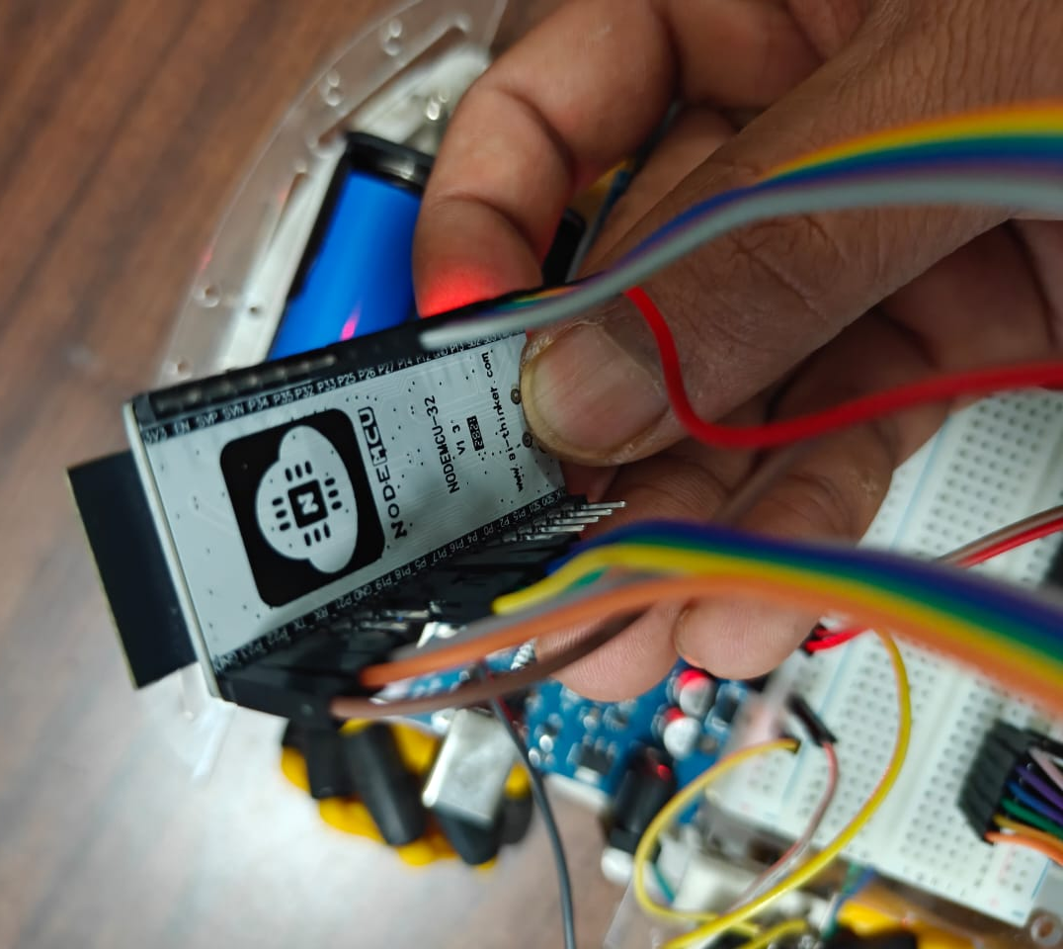
Receiver Circuit Connection

Slide 11
Result
Finally, we made Hand Gesture Controlled Car using MPU6050 and Esp32

